Slide 1
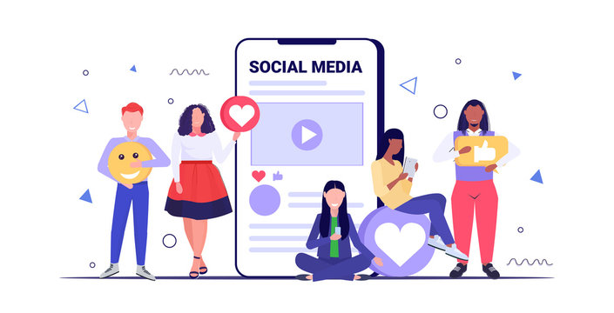
SOCIAL MEDIA ANALYSIS
Submitted BY: Shivani Tiwari

Slide 2
AGENDA
Problem Statement
Data Description
Database Schema
Key Metrics and Visualization
Targeted marketing strategies
Conclusions

Slide 3

PROBLEM STATEMENT
You are hired as a data analyst at Meta and asked to collaborate with the Marketing team. Marketing teams want to leverage Instagram's user data to develop targeted marketing strategies that will increase user engagement, retention, and acquisition. Provide insights and recommendations to address the following objectives.

Slide 4
DATA DESCRIPTION The dataset contain information about 7 tables. Below is an overview of the dataset.
Users Table : Information about users registered
on the platform.
Photo Table : Information about the photos
uploaded by users.
Comments Table : Stores all comments made
by users on photos.
Likes Tables : Tracks which users liked which
photos.
Follows Table : Track users relationships
(followers and followees).
Tags Table : Stores unique tags that are
associated with photos.
Photo Tags Table : Connect photos with tags.
comments_id : unique identifier for each comment
comment_text : text content of a given comment
user_id : unique identifier for each user
photo_id : unique identifier for each photo
created_at : date of interaction in the form like, photos, tags
follower_id : user_id of the follower for a certain user
followee_id : user_id of followee for a certain user
tag_id : unique identifier for each tag
image_url : link to the image posted on the platform
username : username chosen by the user

Slide 5
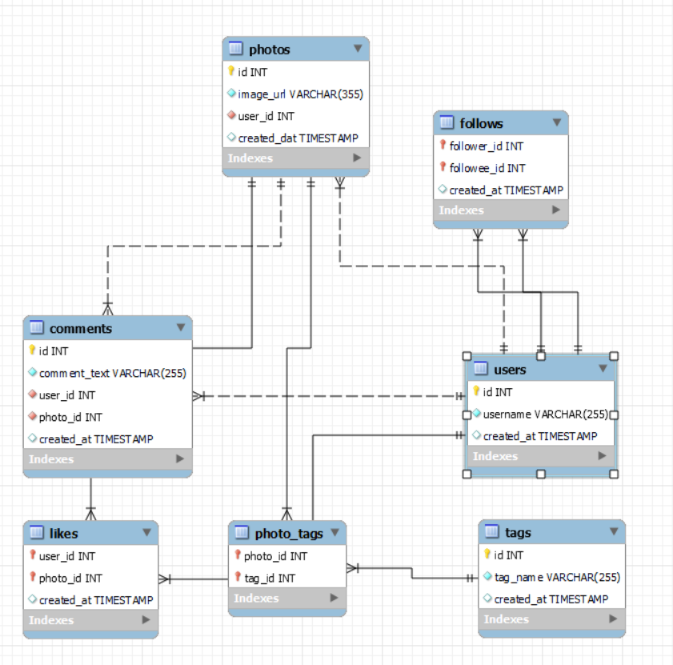
DATABASE SCHEMA

Slide 6
KEY METRICS AND VISUALIZATION
USERS
Activity Wise
Inactive Users: 26
Active Users: 74
The 26 inactive users highlight a potential retention issue.
Joining Year Wise
2016: 65
2017: 35
The drop in new users in 2017, the priority should be on boosting user acquisition.

Slide 7
2. POSTS
26 Users have posted 0 photos, highlighting a large portion of inactive users.
Only 6 users posted more than 6 photos and 1 user posted 12 posts,
Revealing a lack of highly active users on the platform.

Slide 8
3. TAGS There are 21 different tags used by the users.
High Inactivity with Tags
31 users have used 0 tags, also indicating a significant portion of users who do not engage with tags at all.
Few Highly Active Tag Users
Only a small number of users have used more than 5 tags
1 user using up to 15 tags
It demonstrate that few users are highly engaged with tagging.

Slide 9
4. Activity Level
A user who actively posts, tags, comments, and likes are likely to have a higher activity level, indicating a vibrant engagement with the community.
Low Activity: There are 23 users with a total activity between 0 and 9. This indicates that these users are very low in terms of their overall activity (posting, commenting, liking).
Moderate Activity: The next largest group, 8 users, has an activity between 130 and 139, indicating a notable but smaller cluster of users with a moderate activity level.
High Activity: There is only 1 user in the 170-179 activity range, suggesting that very high activity levels are rare.

Slide 10
5. Engagement
Low Engagement: 13 users fall in the 0-49 engagement range, which indicate low interaction or minimal content consumption.
Moderate Engagement:18 users, have an engagement range between 50 and 99, showing that this group engages but not to a significant extent.
High Engagement:13 users in the 300-349 range, which is indicating moderate to high engagement.
Very High Engagement: The highest engagement groups (500-549, 550-599, 600-649, and 700-749) have very few users, only 1-2 users , indicating that high engagement is rare.

Slide 11
ENGAGEMENT BASED ON JOINING YEAR AND FOLLOWER COUNT
Newer users(2017) are more actively contributing content.
Users from 2017 with 76 followers have the highest average engagement.
Users with 77 followers shows highest average posting activity.

Slide 12
CORRELATION BETWEEN UPLOADS & ENGAGEMENT
There is a clear positive correlation between the number of photo uploads and total engagement. As the number of photo uploads increases, so does the average total engagement.
Users with 12 photo uploads have the highest average total engagement (749), showing that users who post more frequently tend to engage more.
Between 10 and 11 uploads, the engagement growth slows down, showing that uploading more content does not always guarantee higher engagement; Quality content is crucial.

Slide 13
USER SEGMENTATION
To develop marketing strategies, understanding of User’s activity and engagement level is important. Thus users are segmented into different categories based on the following categories
Category: Activity Status
No Activity: “Activity = 0”
High Activity: “Activity >= 250”
Low Activity: “Activity < 150”
Moderate Activity: “Activity between 150 and 250”
Category: Engagement Status
No Engagement: “Engagement = o”
High Engagement: “Engagement >= 300”
Low Engagement: “Engagement < 200”
Moderate Engagement: “Engagement between 200 and 300”

Slide 14
USER BASED ON USER BEHAVIOUR AND ENGAGEMENT DATA

Slide 15
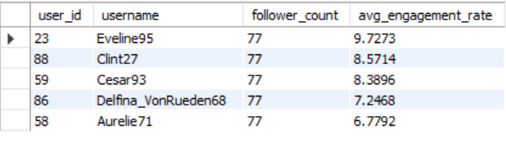
POTENTIAL INFLUENCERS
Users with a High Engagement and High Follower are prime candidates.
The top 5 potential influencers based on their follower count and average engagement rate, ensuring that the most influential users are prioritized for analysis or marketing campaigns.

Slide 16
CONTENT-CENTRIC ANALYSIS
This insight is more valuable for developing personalized
marketing strategies.
It is more actionable for increasing user engagement as
it provides insights into personalized content users .
Most Liked Categories- Party & Fun, Landscape,
Joy-Emotions represents user that are drawn to energetic,
visually appealing, and emotionally uplifting content.
While Least Liked categories like – Photography,
Aesthetics have low overall engagement, they may still
resonate with a niche audience.

Slide 17
USER-CENTRIC ANALYSIS
This insight is more useful for optimizing content
creation and general platform engagement.
It can guide content strategies for audience appeal,
but not as targeted or effective for long term retention
and acquisition
Photography is the only tag category whose people
are using it but not engaging enough to make it to
anyone’s top 3 most liked tags category.
Nearly every user who engages with below tags
including them in their top 3 most liked categories-
Party & Fun, Landscape, Joy-Emotions.

Slide 18
MARKETING STRATEGIES
1.USER RETENTION
Concern:
Users with no activity
Users with no engagement
Users with neither activity nor engagement
Solution:
Reconnection strategies: Suggest relevant content, trending hashtags, and engaging profiles aligned with past user interests to encourage re-engagement.
Special offers: Provide time-sensitive discounts on premium features to incentivize user return.
Onboarding support: Develop concise guides showcasing new functionalities and current trends to assist users in re-navigating the platform.
User feedback initiatives: Conduct short surveys with inactive users to understand reasons for disengagement, offering incentives for participation to inform retention strategies.

Slide 19
2.USER ACQUISITION
Concern:
User decline since 2017
Attracting new users.
Disparity in user engagement: high engagement vs. low engagement
Solution:
Enhance New User Onboarding: Develop a personalized onboarding experience that showcases platform features, popular tags, and user success stories.
Tag Education Initiatives: Implement campaigns to educate users on the benefits of using tags through blog posts and video tutorials.
Referral Program: Implement a referral program that rewards users with discounts or exclusive content for successfully referring new members.
Engagement Strategies: Implement personalized email campaigns that highlight new features, trending content, and tutorials to increase user engagement.

Slide 20
3.USER ENGAGEMENT
Concern:
Need to boost engagement and activity among moderate users.
31 users have not added tags, hindering content discoverability.
Active users typically post a limited number of photos, often between 1 and 3.
Solution:
User Recognition Programs: Implement initiatives like 'User of the Month' awards and photo contests to encourage increased user engagement.
Educational Resources: Provide users with tutorials and webinars focused on maximizing engagement and effective utilization of platform features.
Community Building: Foster community engagement by creating online forums, organizing social events, and launching an ambassador program to promote the platform.
Influencer Partnerships: Collaborate with influential users to attract new members and increase participation among existing users.

Slide 21
CONCLUSION
User Acquisition Effort:
Attract new users through influencer partnerships and ambassador
programs, while implementing educational initiatives to facilitate
effective platform engagement.
Combine influencer partnerships and ambassador programs with
Educational initiatives to attract and effectively onboard new users.
User Retention Strategies:
Implement personalized content recommendations, exclusive offers, and
feedback mechanisms to retain users and address inactivity.
Retain users and address inactivity through personalized content
recommendations, exclusive offers, and proactive feedback mechanisms.
User Engagement initiatives:
Implement re-engagement campaigns, promote tag usage, and foster
community building activities to encourage inactive users and enhance
their overall experience.
Encourage inactive user engagement through re-engagement campaigns,
tag usage promotions, and community building activities.

